Slide 1


Introduction to DevOps
Culture + Tools + Processes
Bhanu Prakash Rangasamudram

Slide 2
Why is DevOps Confusing?
Multiple Concepts
Popular Tools
Infrastructure as Code (IaC)
Terraform
Containerization
Kubernetes
Configuration Management
Ansible
Version Control Systems
Git
Microservices
GitHub
CI/CD Pipelines
Jenkins
Prometheus
Grafana
DevOps can be overwhelming. It involves many different concepts and tools.

Slide 3



What is DevOps?
Culture
Collaboration and shared responsibility.
Processes/Practices
Includes CI/CD, Infrastructure as Code, Monitoring, Automation.
Speed & Reliability
Fast and reliable software delivery.
To make this culture work in real-world projects, we need a DevOps Engineer — someone who understands both development and operations, and can use DevOps tools
A DevOps Engineer helps break the wall between Dev and Ops by using tools like Git, Jenkins, Docker, Kubernetes, Terraform, etc., making the software delivery process smooth, automated, and fast

Slide 4

Example Scenario: Python App
Local Development
Sharing Code
You develop a Python application on your local system.
Code needs to be shared and stored centrally.
Version Control
Different code versions must be maintained.
Imagine developing a Python application. Storing and sharing the code can be challenging. Version control is also necessary.

Slide 5
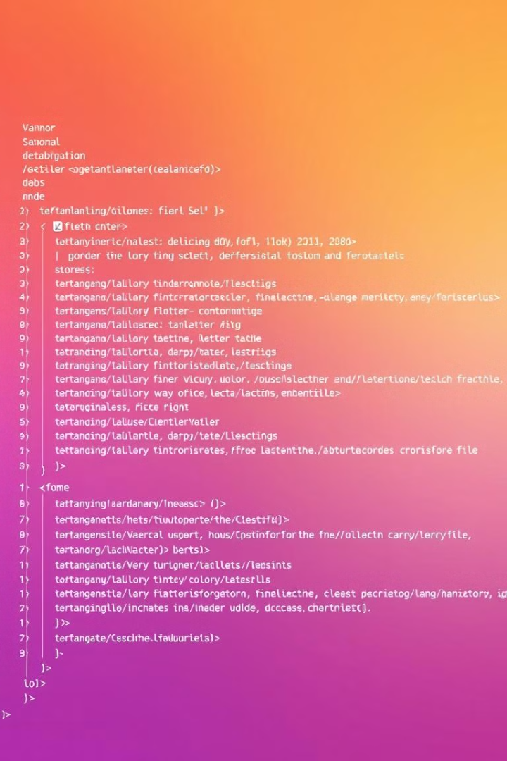
Git & GitHub: Version Control
1
Install Git
Install Git to push code from your local system.
2
Create Repository
Create a repository and push code to GitHub.
3
Collaborate
Others clone to work locally.
Git and GitHub help manage code versions. You can install Git to push code locally. Other developers can clone the repository too.

Slide 6
Deploying on AWS with Automation (IAC)
1
AWS Console
2
Navigate to EC2
3
Configure Settings
Deploy your application to a cloud server for accessibility. Steps include configuring security groups, VPC, and storage. Use Terraform for automation.

Slide 7
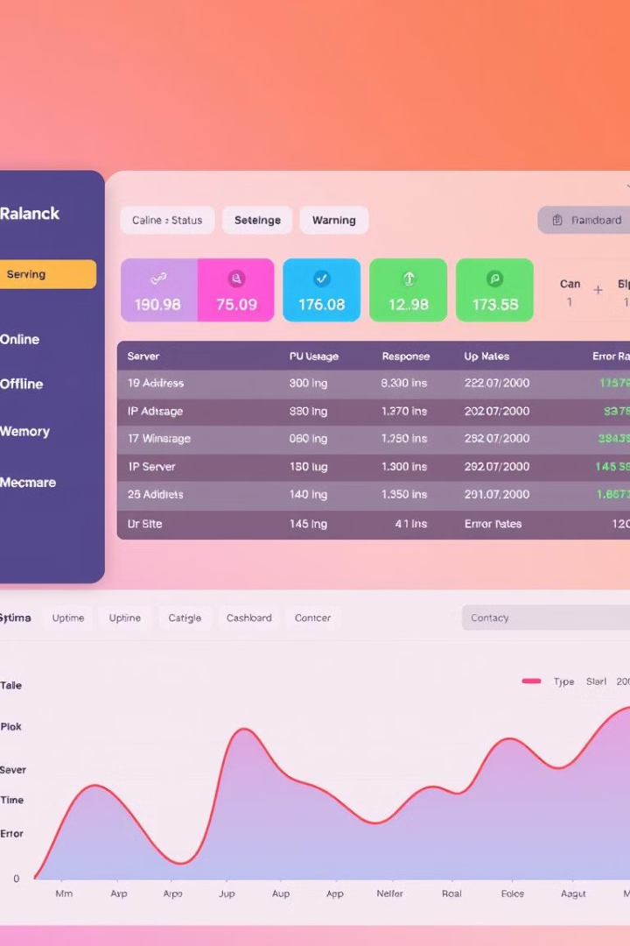



Configuration Management
Ansible
Chef
Puppet
Install Python and dependencies on the server. Automate this using Ansible, Chef, or Puppet. These tools ensure consistency across multiple servers.

Slide 8



CI/CD: Automating Deployment
New Build
2
Create a new build.
Push Code
1
Push updated code.
Deploy
3
Deploy to server.
Automate deployment using CI/CD. GitHub Actions or Jenkins automate the build. Whenever code is pushed, the pipeline runs automatically.

Slide 9
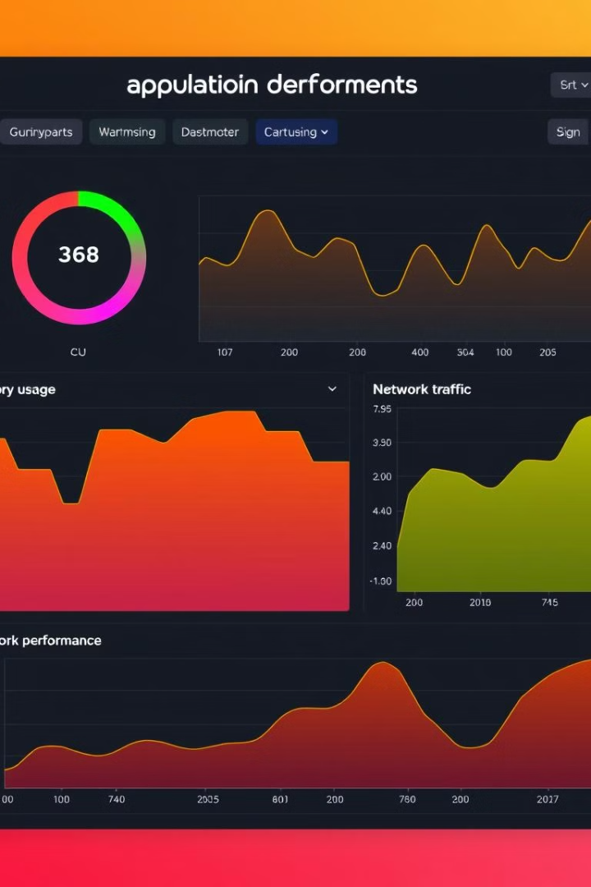
Monitoring the Application
Prometheus
Metrics
Collects metrics.
Grafana
Visualization
Creates dashboards.
Monitor your application's performance post-deployment. Use tools like Prometheus and Grafana. Monitoring ensures application reliability. This helps with availability.

Slide 10
Core DevOps Practices
CI/CD - A key part of DevOps — it's the automation of building, testing, and deploying code
IaC - Use code (like Terraform or CloudFormation) to manage and provision infrastructure automatically and consistently.
Configuration Management - Tools like Ansible, Puppet, or Chef are used to maintain system configurations in a predictable state
Automated Testing - Run unit, integration, and end-to-end tests automatically as part of the pipeline to catch bugs early.
Monitoring & Logging - Track application and infrastructure performance using tools like Prometheus, Grafana, ELK Stack, or CloudWatch
Containerization - Use Docker or similar tools to package apps with their dependencies for consistent deployment across environments
Collaboration & Communication - Foster close cooperation between Dev and Ops teams using tools like Slack, Jira, Confluence, etc.

Slide 11
Advanced DevOps
GitOps - Manage infrastructure and app deployment using Git as the source of truth (e.g., with Argo CD, Flux)
DevSecOps - Integrate security scanning and best practices into every step of the DevOps pipeline
Chaos Engineering - Intentionally break things in staging/production to test system resilience

Slide 12
DevOps vs CI/CD
DevOps is the bigger umbrella that includes many practices and tools to streamline software delivery.
CI/CD is one of the most important practices under that umbrella — it's the automation engine of DevOps.

Slide 13
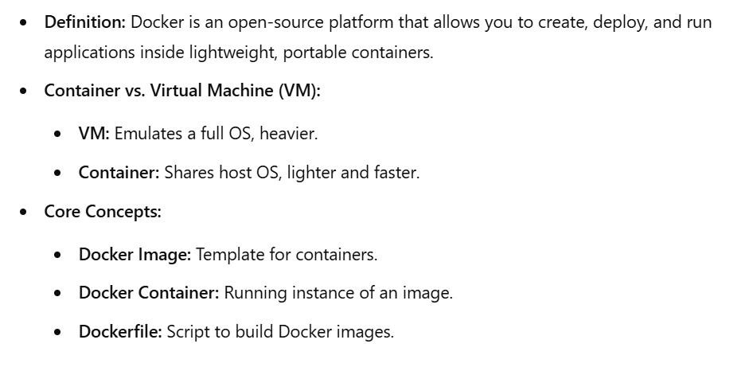
Introduction to Docker

Slide 14

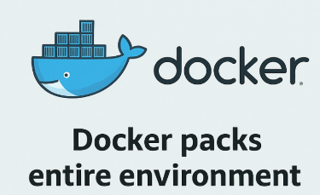
Docker in a nutshell
Docker packs the entire environment — including the application, its dependencies, libraries, and configuration — into a container image

Slide 15
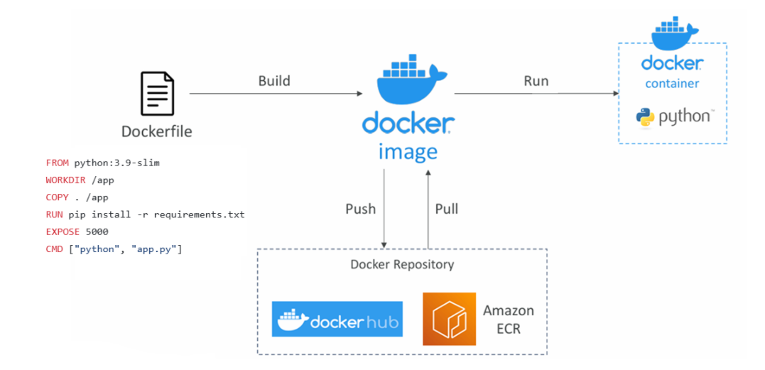
Docker Overview

Slide 16
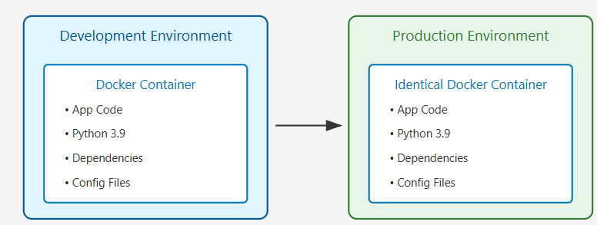
Consistent Environment

Slide 17
Need for Orchestration
Will you be able to manage 100’s of containers on your own?
Have to ensure that Resources are available
Have to check if any container is crashed and deploy the crashed container again
Have to ensure that containers are distributed across the nodes
Have to do the load-balancing
Scaling will be manual
The system ensures your app runs reliably across multiple nodes, adjusts resources dynamically, and recovers from failures automatically.

Slide 18
Orchestration Simplified
Think of an orchestra in music:
Each musician (container) plays their instrument (task) individually.
The conductor (orchestrator like Kubernetes) ensures everyone starts, stops, and plays in harmony, creating a beautiful symphony (application).
In Docker orchestration, the orchestrator ensures all your containers work together to deliver a seamless application experience.

Slide 19
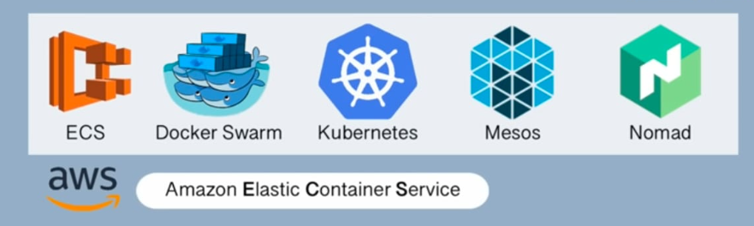
Container Orchestration Tools
For Managing, Scaling and deploying containers

Slide 20
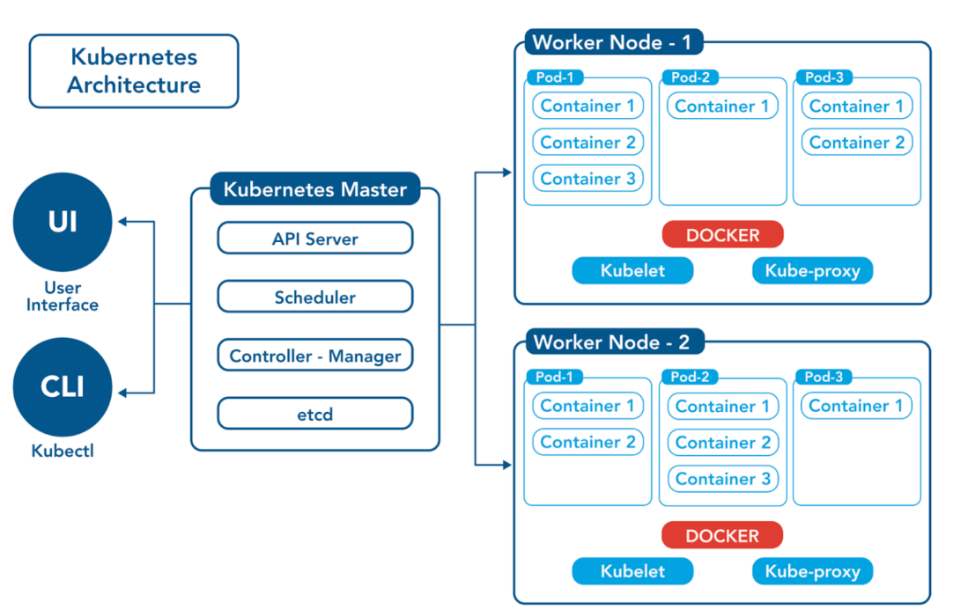
K8’s Architecture

Slide 21
Jenkins Pipeline
Feature | Declarative (steps) | Scripted (script)
Simple shell, echo | ✅ Allowed | ✅ Allowed
Variable assignment | ❌ Not Allowed | ✅ Allowed
Groovy logic | ❌ Not Allowed | ✅ Allowed
Docker API usage | ❌ Not Allowed | ✅ Allowed

